Slide 1
Knowledge Representation

Slide 2
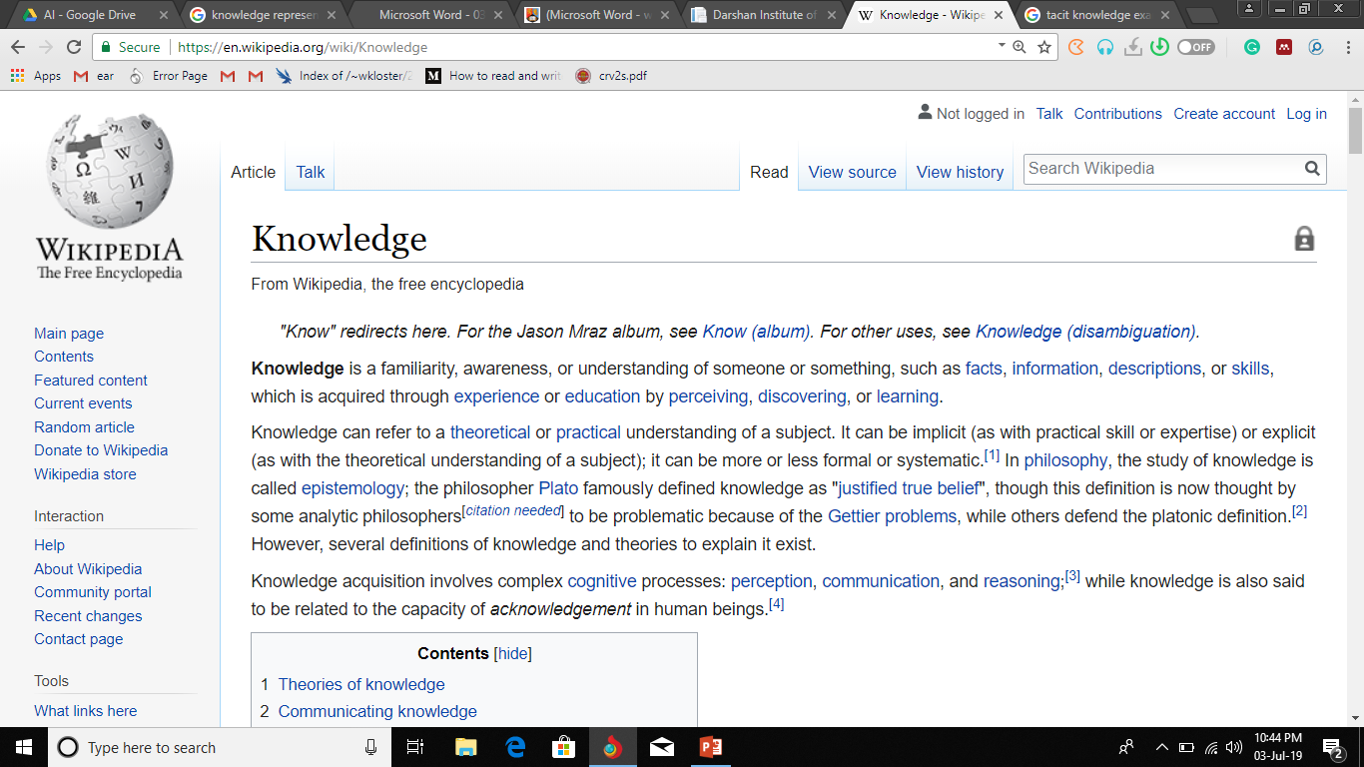

Slide 3
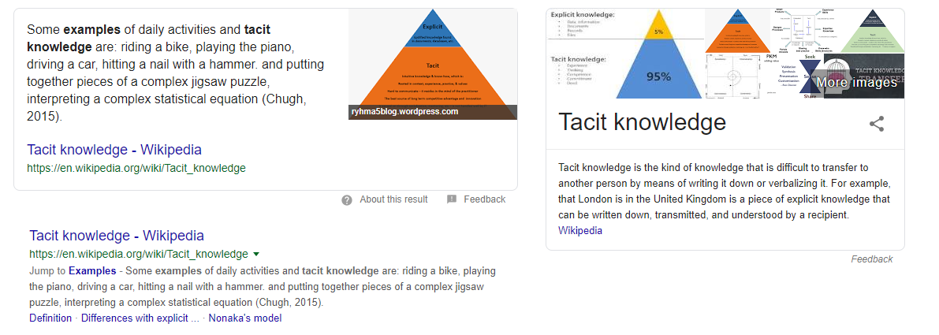

Slide 4
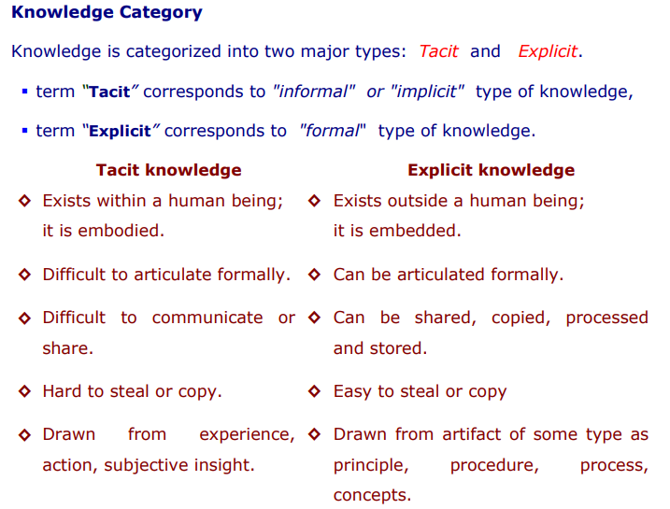

Slide 5
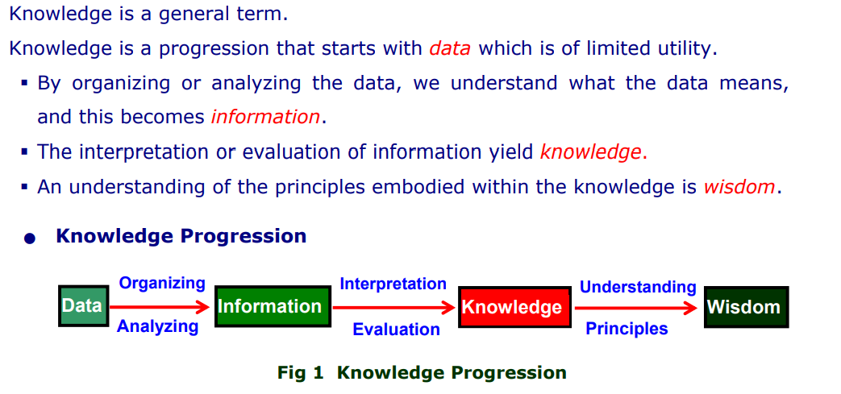
Take Example of ImageNet Dataset

Slide 6
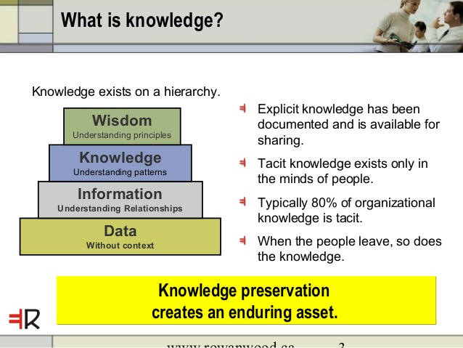

Slide 7
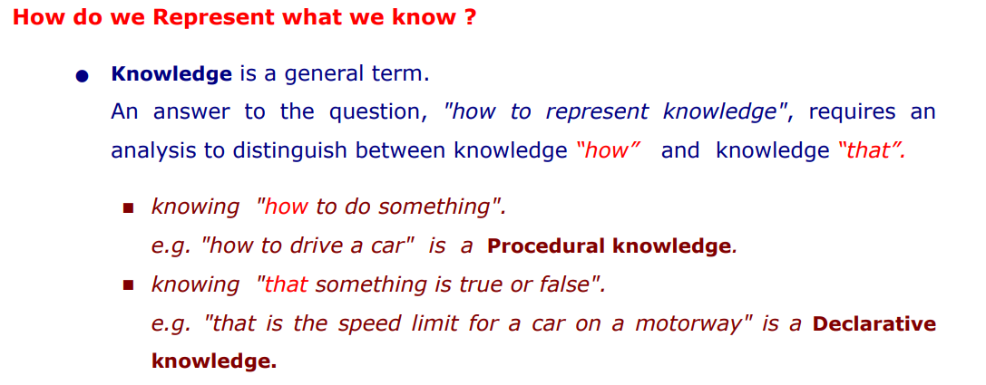

Slide 8
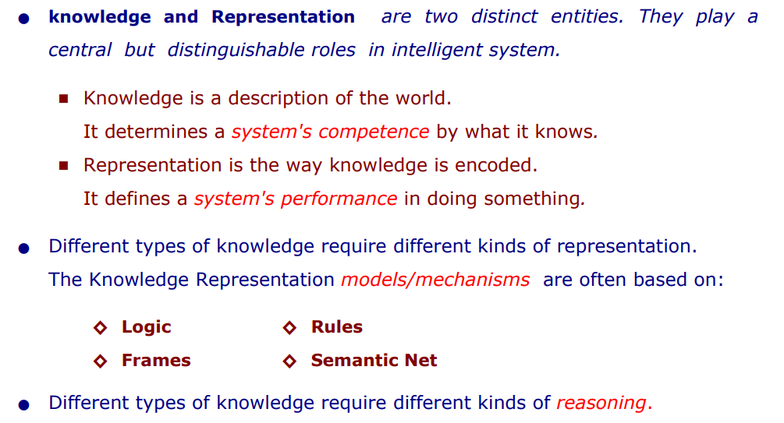
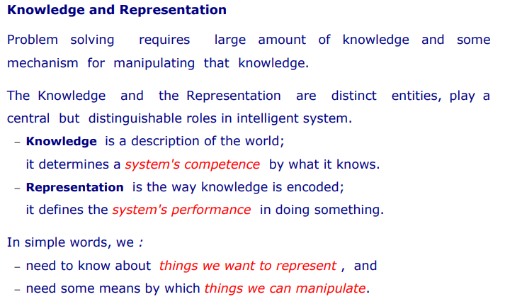
Competence - the ability to do something successfully or efficiently

Slide 9
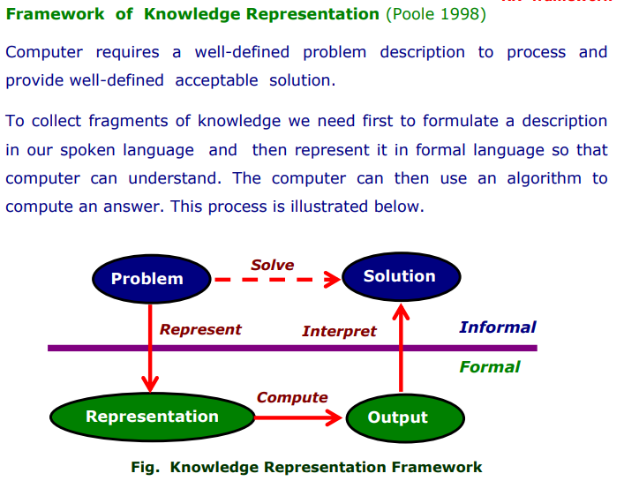

Slide 10
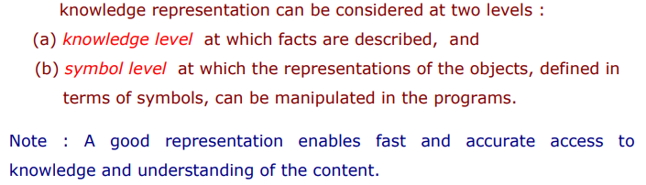

Slide 11
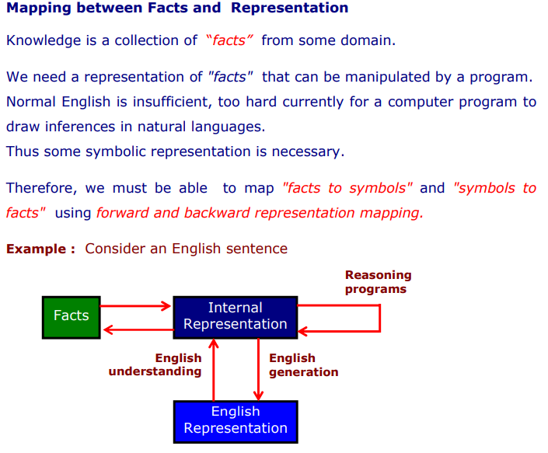

Slide 12
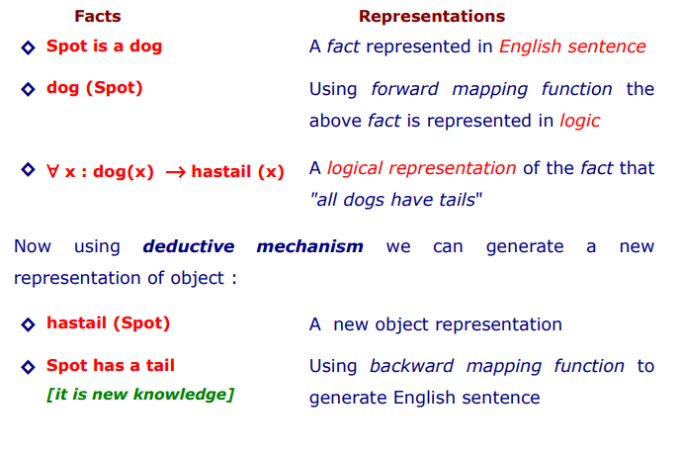

Slide 13
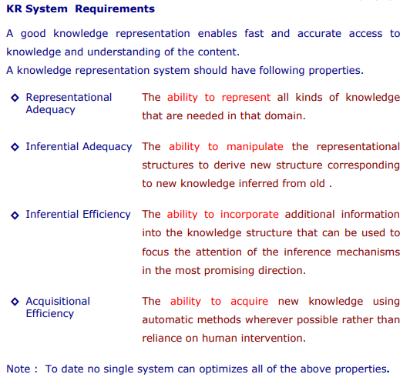
Properties of KR
Adequacy - the fact of being enough/acceptable/sufficient or satisfactory for a particular purpose
Inferential - characterized by or involving conclusions reached on the basis of evidence and reasoning

Slide 14
Approaches to KR/ Types of KR/ Schemes of KR
Relational Knowledge
Inheritable Knowledge
Inferential Knowledge
Declarative Knowledge

Slide 15
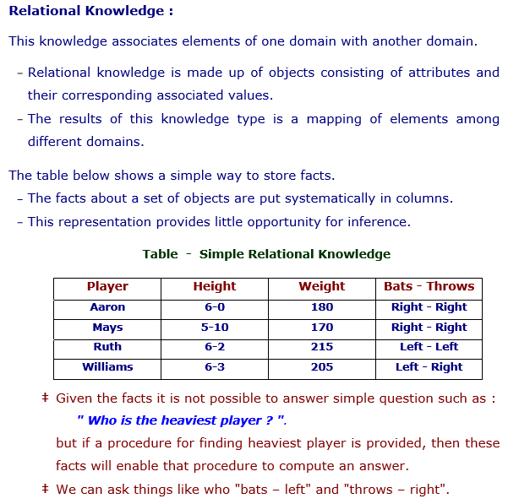

Slide 16
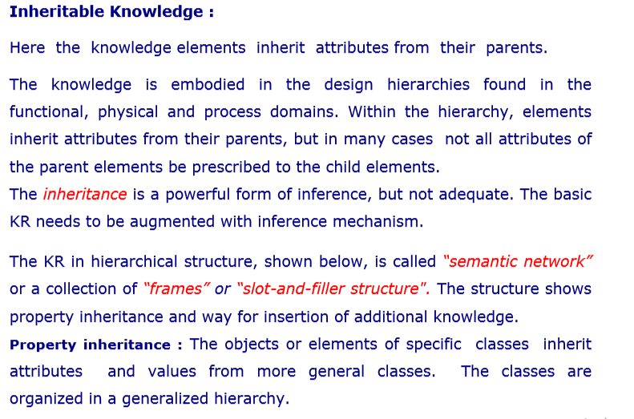

Slide 17
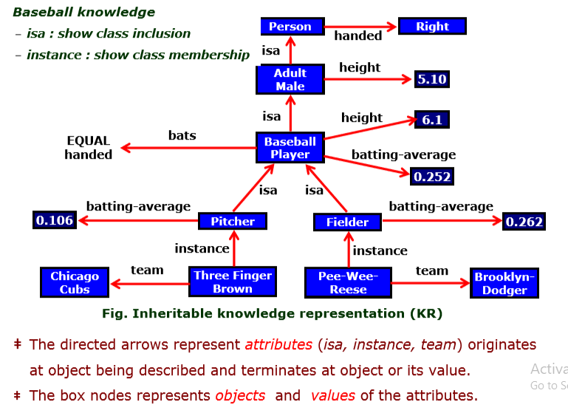

Slide 18
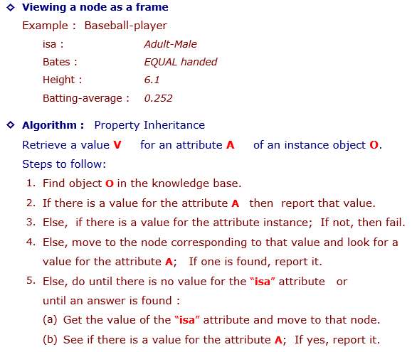
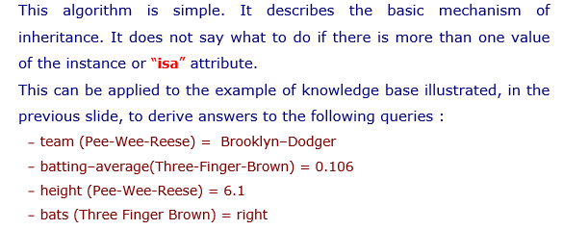

Slide 19
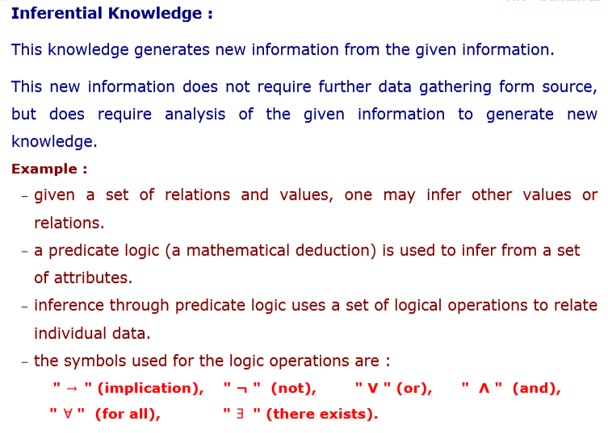

Slide 20
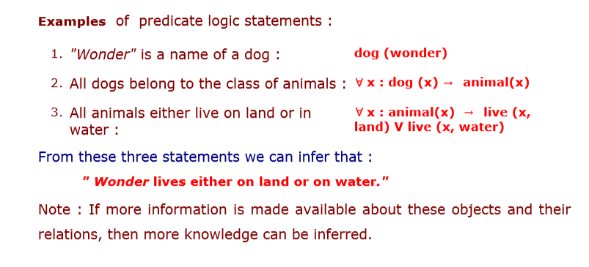

Slide 21
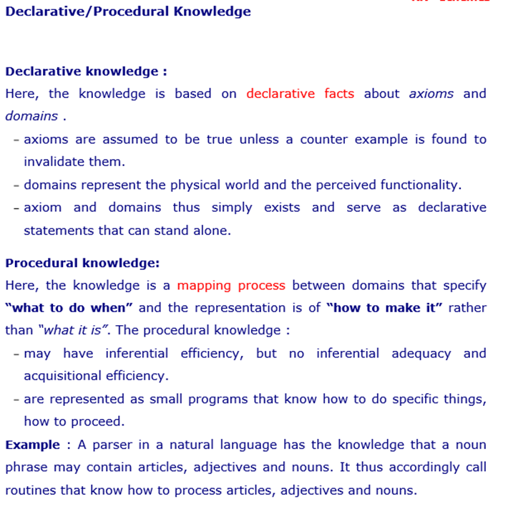

Slide 22
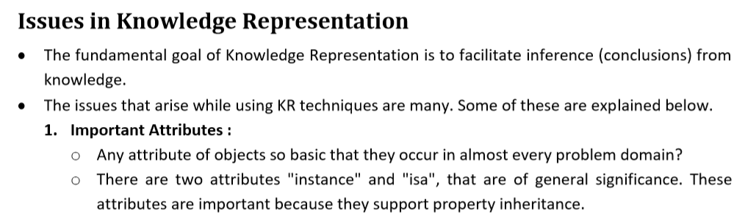
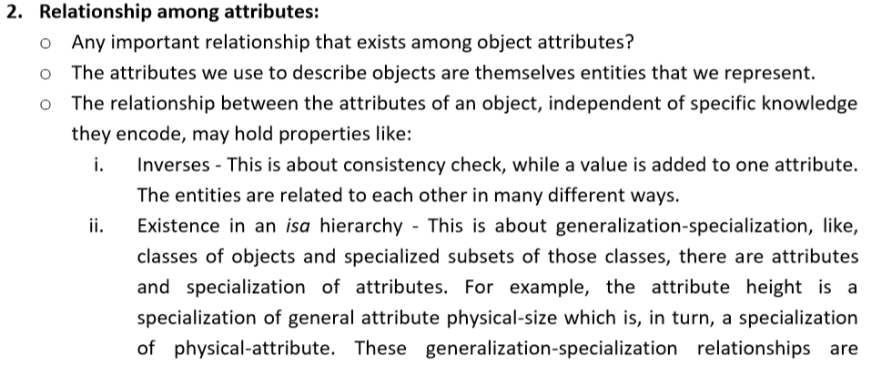

Slide 23
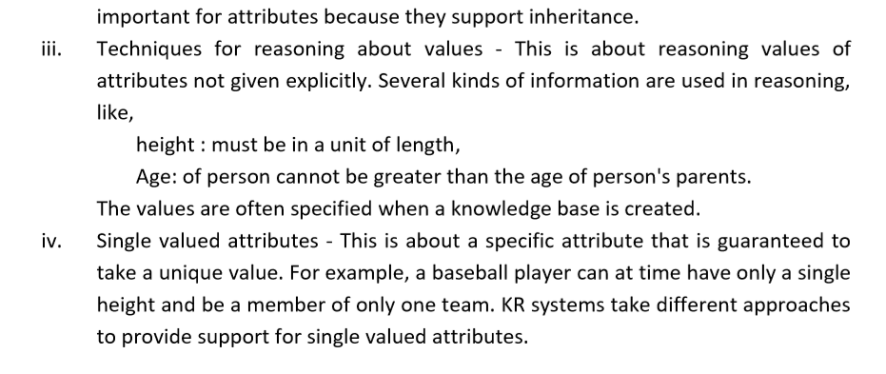

Slide 24
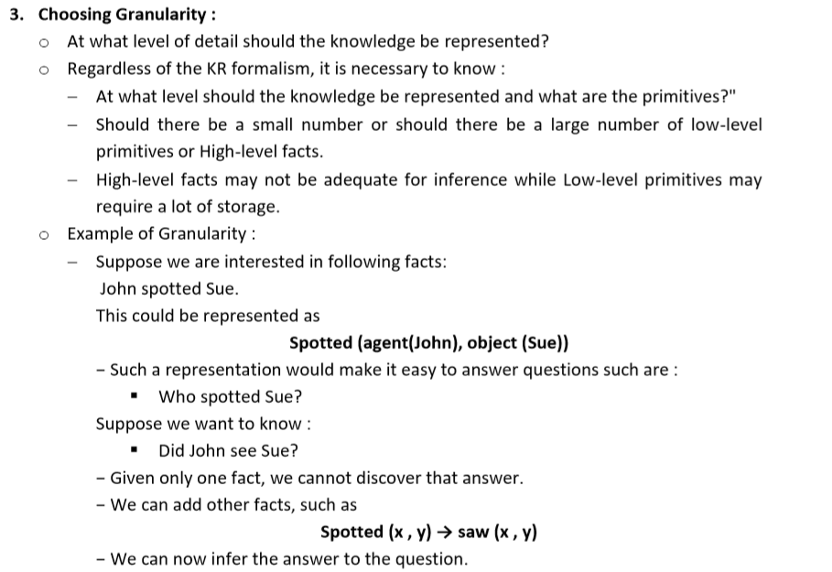

Slide 25
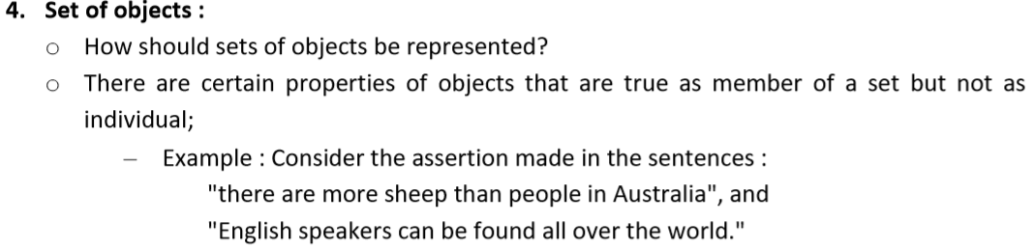
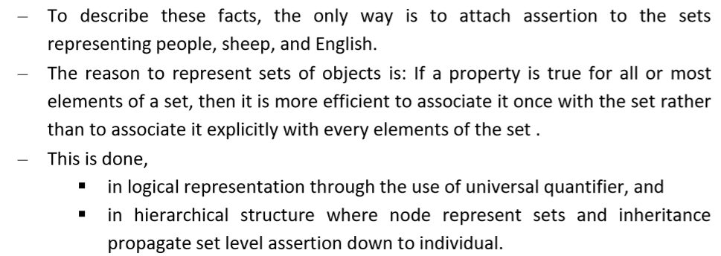

Slide 26
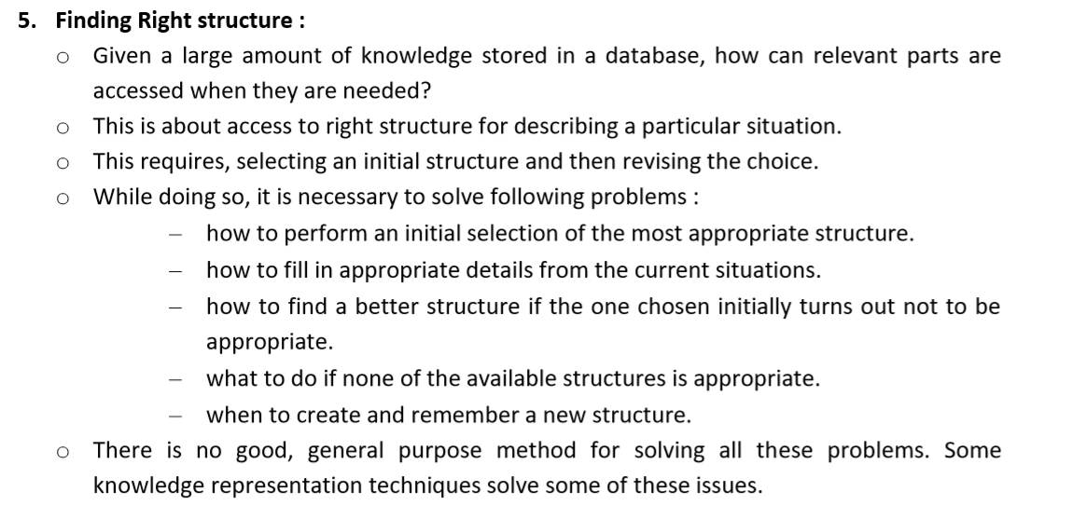

Slide 27
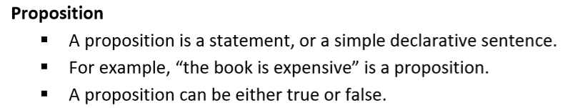
But not both

Slide 28
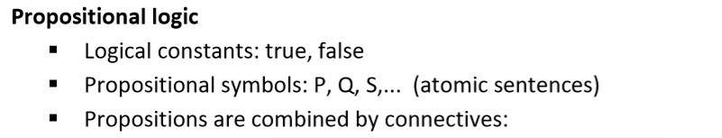
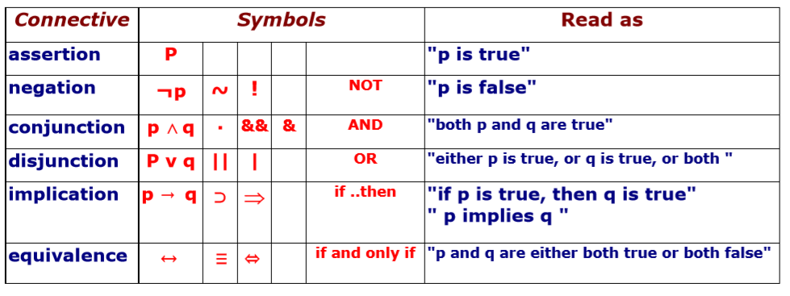

Slide 29
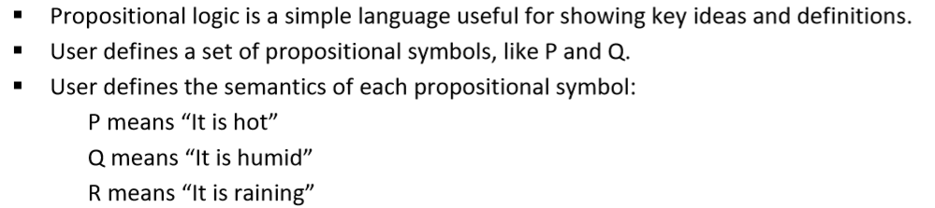
If it is humid then it is hot.
Q → P
If it is hot and humid then it is not raining.
P ^ Q → ﬢR

Slide 30
All cars have 4 wheels.
Some auto have 4 wheels.
X1, X2,..Xn (Not possible PL)
1. What time is it?
2. Go out and play.
3. x + 1 = 2.
The above sentences are not propositions as the first two do not have a truth value, and the third one may be true or false.
1. The sun rises in the East and sets in the West.
2. 1 + 1 = 2
3. 'b' is a vowel.
All of the above sentences are propositions, where the first two are Valid(True) and the third one is Invalid(False).

Slide 31
Consider the following two statements:
Every CSE student must study discrete mathematics.
Jackson is a CSE student.
It looks “logical” to deduce that therefore, Jackson must study discrete mathematics.
However, this cannot be expressed by propositional logic...you may try it, but you can already notice that none of the logical operators we have learnt are applicable here.
We need new tools! Predicate Logic

Slide 32
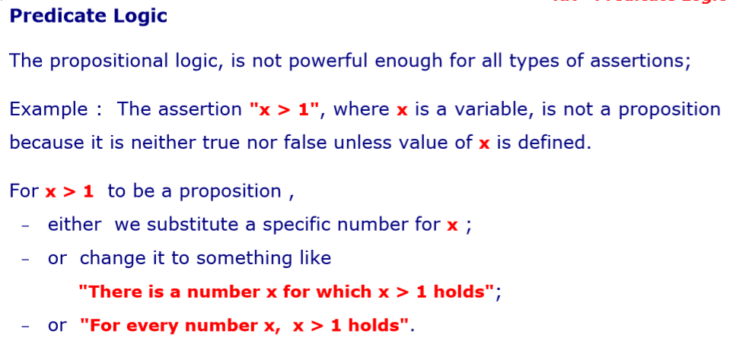

Slide 33
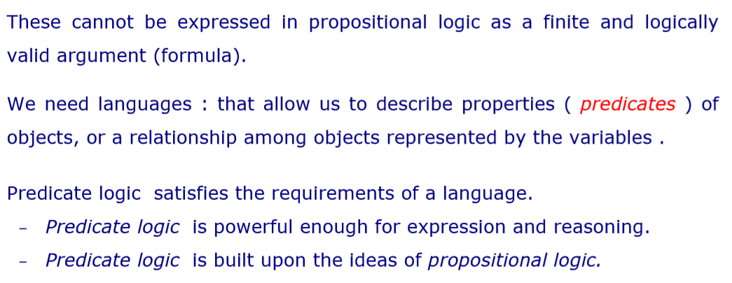
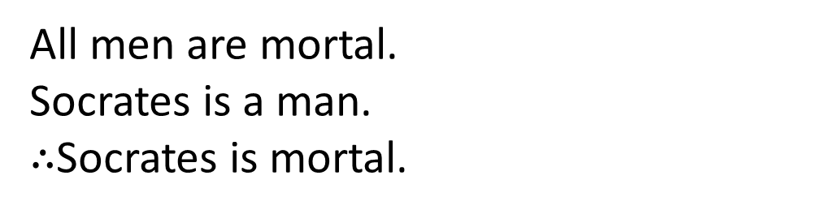
All men are mortal.
Socrates is a man.
$∴$Socrates is mortal.

Slide 34
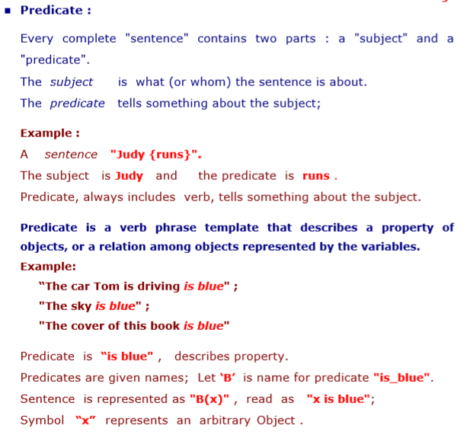

Slide 35
Example: Nate is a student at UT.
What is the subject? What is the predicate?
Manay is tall.
tall(manay).
Cat is black.
Cat(x) → Black(x)
Definition: A predicate is a property that a variable or a finite
collection of variables can have. A predicate becomes a proposition
when specific values are assigned to the variables. P(x1, x2, ..., xn) is
called a predicate of n variables or n arguments.
Example: She lives in the city.
P(x,y): x lives in y.
P(Mary, Austin) is a proposition: Mary lives in Austin

Slide 36
Some CSE boys like programming.
like(girls, non-veg)
All CSE boys like programming.
like(CSE_boys, cricket)
Here meaning is totally different but predicate is same. WHICH IS NOT VALID.

Slide 37
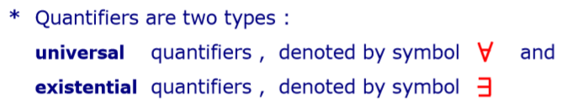
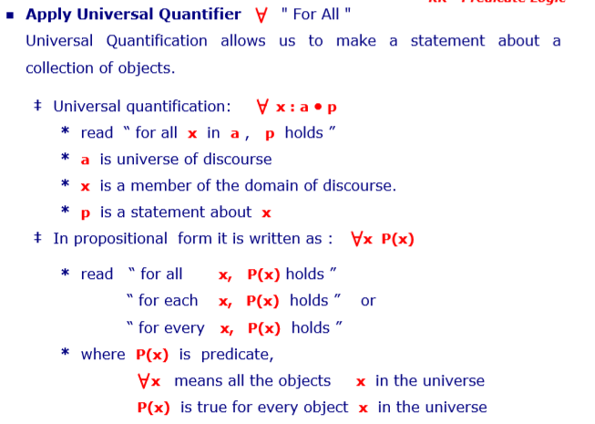

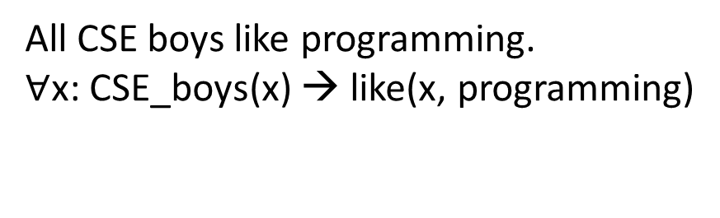
All CSE boys like programming.
$∀$x: CSE_boys(x) → like(x, programming)

Slide 38
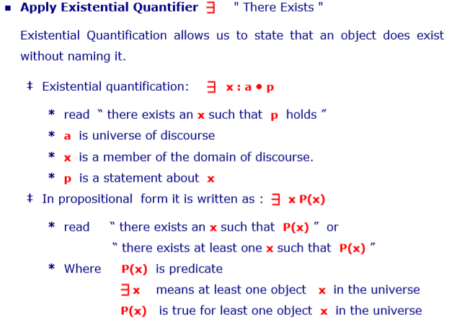


Some girls like non-veg.
$∃$x: girls(x) ^ like(x, non-veg)

Slide 39
1. All birds fly. In this question the predicate is "fly(bird)." And since there are all birds who fly so it will be represented as follows. ∀x bird(x) →fly(x).
2. Every man respects his parent. In this question, the predicate is "respect(x, y)," where x=man, and y= parent. Since there is every man so will use ∀, and it will be represented as follows: ∀x man(x) → respects (x, parent).
3. Some boys play cricket. In this question, the predicate is "play(x, y)," where x= boys, and y= game. Since there are some boys so we will use ∃, and it will be represented as: ∃x boys(x) → play(x, cricket).
4. Not all students like both Mathematics and Science. In this question, the predicate is "like(x, y)," where x= student, and y= subject. Since there are not all students, so we will use ∀ with negation, so following representation for this: ¬∀ (x) [ student(x) → like(x, Mathematics) ∧ like(x, Science)].
5. Only one student failed in Mathematics. In this question, the predicate is "failed(x, y)," where x= student, and y= subject. Since there is only one student who failed in Mathematics, so we will use following representation for this: ∃(x) [ student(x) → failed (x, Mathematics) ∧∀ (y) [¬(x==y) ∧ student(y) → ¬failed (x, Mathematics)].

Slide 40
Marcus was a man
Man(Marcus)
Marcus was a Pompeian
Pompeian(Marcus)
All Pompeians were Romans
∀x [Pompeian(x) ⊃ Roman(x)]
Caesar was a ruler
Ruler(Caesar)
All Romans were either loyal to Caesar or hated him
∀x [Roman(y) → (LoyalTo(x,Caesar) ∨ Hate(x,Caesar))]
People only try to assassinate rulers they aren't loyal to
∀x∀y[(Person(x) ∧ Ruler(y) ∧ TryAssassinate(x,y)) →¬LoyalTo(x,y)]
Marcus tried to assassinate Caesar
TryAssassinate(Marcus, Caesar)
Everyone is loyal to someone
∀x ∃y LoyalTo(x,y)

